Slide 1
Narcan Administration Training
Sponsored by the Santa Monica College Student Health Services Naloxone Distribution Project (NDP) through the California Department of Healthcare Services (DHCS)

Slide 2
What is the Naloxone Distribution Project (NDP)?
The Naloxone Distribution Project (NDP) is administered by the Department of Health Care Services (DHCS) to combat opioid overdose-related deaths throughout California.
The NDP aims to reduce opioid overdose deaths through the provision of free naloxone, also called Narcan.

Slide 3
What is Narcan (naloxone)?
Narcan is a life-saving medication that reverses an opioid overdose while having little to no effect on an individual if opioids are not present in their system.
Narcan works by blocking the opioid receptor sites and reversing the toxic effects of the overdose. It has few known adverse effects and no potential for abuse.
Narcan is administered when a patient is showing signs of opioid overdose. The medication can be given by intranasal spray, intramuscular (into the muscle), subcutaneous (under the skin), or by intravenous injection.

Slide 4
Other Facts About Narcan
Can Narcan be used for a fentanyl overdose?
  Yes. Fentanyl is a synthetic opioid, so Narcan can be used to reverse a fentanyl overdose.
In the State of California, can individuals over the age of 12 receive Narcan without the consent of a parent or guardian?
  California has no statute requiring minors to obtain parental or guardian consent prior to receiving Narcan.
  Additionally, Civil Code §1714.22 indicates that naloxone may be distributed to a family member, friend, or other person in a position to assist a person at risk of a suspected opioid-related overdose.

Slide 5
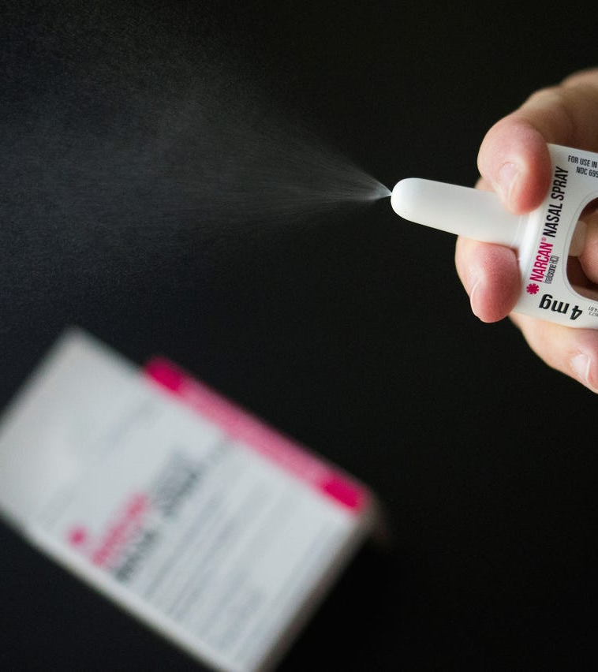
What is NARCAN
Nasal Spray?
NARCAN® Nasal Spray is a prescription medicine used for the treatment of an opioid emergency such as an overdose or possible overdose.
NARCAN® Nasal Spray is to be given right away and does not take the place of emergency medical care.
Signs of a possible overdose are:
  Breathing problems
  Severe sleepiness or not being able to respond

Slide 6
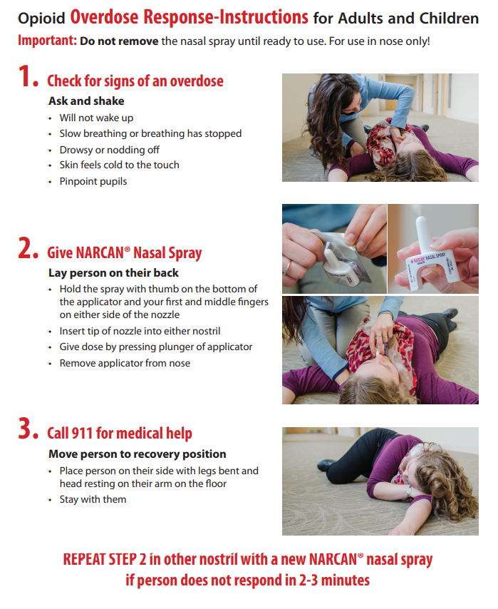
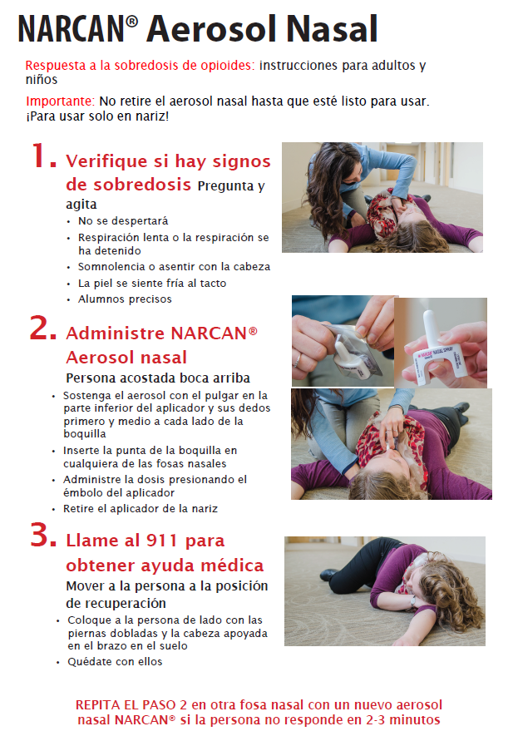
How to Administer NARCAN Nasal Spray

Slide 7

Additional Resources
Naloxone is available free of charge at the below County of Los Angeles Public Health Centers:
Asian American Drug Abuse Program (AADAP) 652 E. Manchester Boulevard, Inglewood, CA 90301
Bienestar Human Services East Los Angeles Storefront 5400 E. Beverly Boulevard, Los Angeles, CA, 90022
Homeless Outreach Program Integrated Care System (HOPICS) 5715 S. Broadway, Los Angeles, CA 90037
Homeless Outreach Program Integrated Care System (HOPICS) 5849 Crocker Street, Unit X, Los Angeles, CA 90003
Homeless Health Care Los Angeles (HHCLA) 512 E. 4th Street, Los Angeles, 90013
Venice Family Clinic Common Ground 622 Rose Avenue, Venice, CA 90291

